Slide 1

Lesson 10 final project
Smoking. Still bad for you.

Slide 2
Information gathered from
#cigarette data set Ecdat package
install.packages("Ecdat")
library(Ecdat)
library(ggplot2)
library(dplyr)
head(Cigarette)

Slide 3
#Create a boxplot of the average number of packs per capita by state. Which states have the highest number of packs? Which have the lowest?
#Find the median over all the states of the number of packs per capita for each year. Plot this median value for the years from 1985 to 1995. What can you say about cigarette usage in these years?
#Create a scatter plot of price per pack vs number of packs per capita for all states and years.
#Are the price and the per capita packs positively correlated, negatively correlated, or uncorrelated? Explain why your answer would be expected.
#Change your scatter plot to show the points for each year in a different color. Does the relationship between the two variable change over time?
#Do a linear regression for these two variables. How much variability does the line explain?
#The plot above does not adjust for inflation. You can adjust the price of a pack of cigarettes for inflation by dividing the avgprs variable by the cpi variable. Create an adjusted price for each row, then re-do your scatter plot and linear regression using this adjusted price.
#Create a data frame with just the rows from1985.
#Create a second data frame with just the rows from 1995. Then, from each of these data frames,
#get a vector of the number of packs per capita.
# Use a paired t-test to see if the number of packs per capita in 1995 was significantly different than the number of packs per capita in 1985.
In the process of doing this project, have any questions come to mind that this data set could answer? If so, pick one and do the analysis to find the answer to your question.

Slide 4
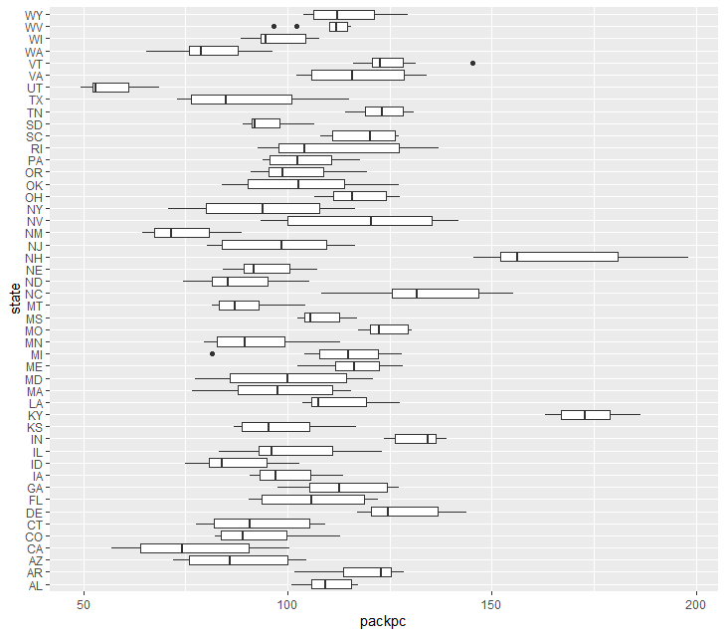
average # of packs per capita by state
The highest state is New Hampshire, while the lowest state is Utah

Slide 5
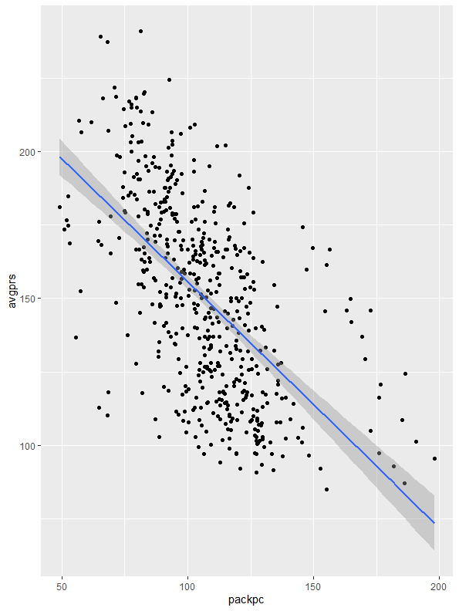
#create a scatterplot of price per pack vs number of packs per capita for all states and years
ggplot(Cigarette, aes(x=packpc, y=avgprs)) + geom_point() + geom_smooth(method = lm)

Slide 6
Are the per capita packs positively correlated, negative correlated, or uncorrelated?
This is a negative correlation; the price and the packs per capita are moving in opposite directions. Higher pack prices did not affect the amount of packs sold

Slide 7
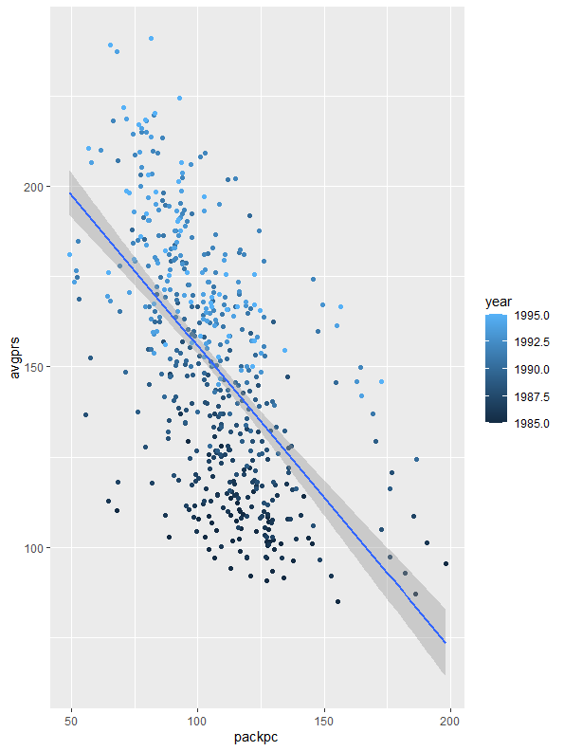
Price vs pack(s) sold over the yea rs (1985-1995)
As the price in packs increased the amount of packs purchased remained much the same.

Slide 8
Average price vs price per capita adjusted for inflation
Price per pack still only affects the average price by 34%

Slide 9
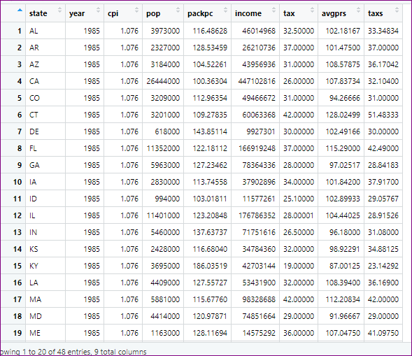
#Create a data frame with just the rows from 1985
Packs1985 <- Cigarette %>% filter (year== 1985) View(Packs1985)

Slide 10
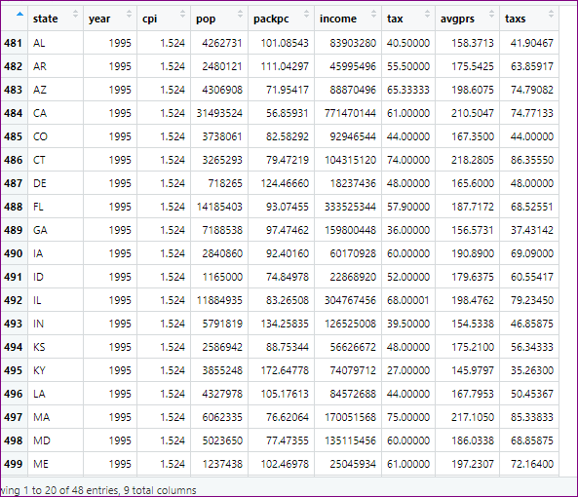
#Create a second data frame with just the rows from 1995 Then, from each of these data frame #get a vector of the number of packs per capita.
#48 rows
#Create a second data frame with just the rows from 1995
Packs1995 <- Cigarette %>% filter (year== 1995)
View(Packs1995)
#48 rows
#from each of these data frames get a vector of the number of packs per capita
PPC <- c(Packs1985$packpc, Packs1995$packpc)
View(PPC)
#96 rows

Slide 11
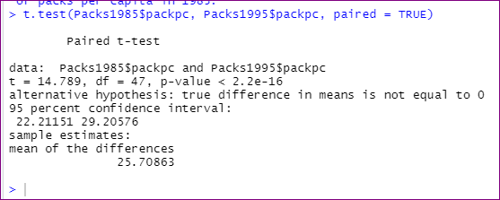
# Use a paired t-test to see if the number of packs per capita in 1995 was significantly different than the number of packs per capita in 1985.
t.test(Packs1985$packpc, Packs1995$packpc, paired = TRUE)
There was no difference in packs per capita between the two years

Slide 12
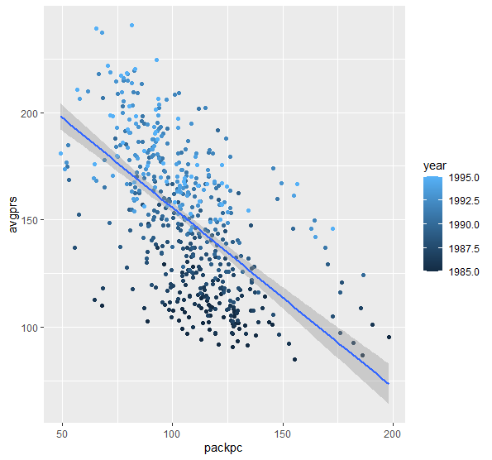
In the process of doing this project, have any questions come to mind that this data set could answer? If so, pick one and do the analysis to find the answer to your question.
From the plot, the increase in pack price did not decrease the amount of smoking being done.
The 80s were a time of lots of partying ,prices were still relatively reasonable, there was a lot of smoking.

Slide 13
#cigarette data set ecdat package
install.packages("Ecdat")
library("Ecdat")
library(ggplot2)
library(dplyr)
library(corrplot)
head(Cigarette)
View(Cigarette)
#Create a boxplot of the average number of packs per capita by state. Which states have the highest number of packs? Which have the lowest?
ggplot(Cigarette, aes(x = packpc, y = state)) + geom_boxplot()
#NH THE HIGHEST UT THE LOWEST
#Find the median over all the states of the number of packs per capita for each year. Plot this median value for the years from 1985 to 1995. What can you say about cigarette usage in these years?
gm_medians <- Cigarette %>% group_by(year, state) %>% summarise(packpc = median(packpc) , packpc = median(packpc)) %>% arrange(desc(packpc))
View(gm_medians)
# from 1985-1995 more cigarettes were sold in New Hampshire and Kentucky
ggplot(gm_medians, aes(x=packpc, y=year)) + geom_point()
#smoking has remained at a mostly constant pace with a small slowdown in the late 80s to early 90s and picking back up
#Create a scatter plot of price per pack vs number of packs per capita for all states and years
ggplot(Cigarette, aes(x=packpc, y=avgprs)) + geom_point() + geom_smooth(method = lm)
#as price increased the number of packs purchased remained the same
#Change your scatter plot to show the points for each year in a different color. Does the relationship between the two variable change over time?
ggplot(Cigarette, aes(x=packpc, y=avgprs, color = year)) + geom_point() + geom_smooth(method = lm)
#there is no relationship between price per pack vs number of packs sold
#Do a linear regression for these two variables. How much variability does the line explain?
regression <- lm(avgprs ~ packpc, Cigarette)
summary(regression)
#price per pack affects average pack by 34% not a lot
#The plot above does not adjust for inflation. You can adjust the price of a pack of cigarettes for inflation by dividing the avgprs variable by the cpi variable. Create an adjusted price for each row, then re-do your scatter plot and linear regression using this adjusted price.
Inflate <- Cigarette %>% mutate(inflation = avgprs / cpi)
ggplot(Inflate, aes(x=packpc, y=avgprs, color = year)) + geom_point() + geom_smooth(method = lm)
regression <- lm(avgprs ~ packpc, Inflate)
summary(regression)
#Create a data frame with just the rows from 1985
Packs1985 <- Cigarette %>% filter (year== 1985)
View(Packs1985)
#48 rows
#Create a second data frame with just the rows from 1995
Packs1995 <- Cigarette %>% filter (year== 1995)
View(Packs1995)
#48 rows
#from each of these data frames get a vector of the number of packs per capita
PPC <- c(Packs1985$packpc, Packs1995$packpc)
View(PPC)
# Use a paired t-test to see if the number of packs per capita in 1995 was significantly different than the number of packs per capita in 1985.
t.test(Packs1985$packpc, Packs1995$packpc, paired = TRUE)

